Slide 1

How to make a github repo

Slide 2
STeP 1 install git bash
Click here to go to the webpage

Slide 3
STEP 2 Open git bash

Slide 4
Step 3: Navigate to THE right folder

Slide 5
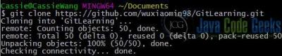
STEP 4 git clone

Slide 6
GIT ADD/remove
Use git add “insert file” to stage the files
Use git remove “insert file” to remove the file from staging

Slide 7
Git commit
Git commit –m “the message to put with the commit”

Slide 8
Git push
Use git push to push the files to the repo

Slide 9
Git pull
Git pull is used to retrieved files from the repo

